Slide 1
Senate Study Commission Report on Improving Providence Schools

Slide 2
About the Commission
Membership
Charge
Who Testified

Slide 3
Commission Members
Senator Samuel D. Zurier – Chair
Senator Meghan Kallman – Senate Appointee
Senator Jessica de la Cruz – Senate Appointee
Zachary Scott – Providence Public Schools
Lisa Odom-Villella – RI Dept. of Education
Thomas Kerr-Vanderslice – City of Providence
Erlin Rogel – Providence Public School Board
Wobberson Torchon – Principal, Mt. Pleasant High School
Jeremy Sencer – RI Federation of Teachers
Nirva LaFortune – PPSD Parent
Marcus Tremblay – Student, Classical High School
Susan Lusi – Ex Officio Member
Steve Smith – Ex Officio Member

Slide 4
The Commission’s Charge & Its Importance
Review the professional standards and the labor-management relationship for employees of the Providence Public Schools, particularly as defined by State law; and
Develop recommendations that promote a rewarding professional environment and great school-based flexibility and accountability for the district’s professional educators.
This is important because high quality educators, working together,
create powerful student learning.

Slide 5
People Who Testified (in order of appearance)
Jo Anderson Jr. – Founder, Consortium for Educational Change
Heather Peske – President, National Council on Teacher Quality
Nancy Mullen – Retired Principal (Providence and Massachusetts)
Paul Reville – Founding Director, Harvard University Education Redesign Lab
Evan Stone – Co-Founder, Educators for Excellence
John Papay – Director, Brown University Annenberg Institute for School Reform
Peter McWalters – Former Commissioner, RI Department of Education
Andres Alonso – Former Harvard University Professor of Practice and CEO of Baltimore Public Schools
Saul Rubinstein – Director, Rutgers University Collaborative School Leadership Initiative

Slide 6
Overview
Vision for Providence Schools
Today’s Reality
Shared accountability
- What it is
Why it’s important for teachers & kids
Commission’s recommendations

Slide 7

The Vision: Shared Accountability
Excellent education for every student
Schools that attract and retain high quality, diverse teachers and other educators
Educators who work together to educate students well
Teachers have meaningful participation in decision-making
Teachers are responsible for maintaining high standards within the profession
Notes:
Very different than what we have now:
Education in Providence remains a crisis for the city's approximately 20,000 public school students, their families, and the state of Rhode Island.
In school year 2023, 13.1 percent of Providence students were proficient in math, and 16.6 percent in English; 49 percent of students missed 10 percent or more of the school year; and student learning has not returned to pre-pandemic levels, particularly in math. Fifteen percent of Rhode Island public school students attend Providence Public Schools, and 82 percent of Providence students are economically disadvantaged.
Teachers and building leaders leaving for other districts.
Families flocking to charter schools.

Slide 8

Shared Accountability is Crucial for Kids
Teachers working together improves student learning
Share best practices and data
Offer informed insights
Learning from one another
Every teacher needs to be good; but research shows that good teachers, working together, help students learn even more
Notes:
Analogies:
OR
The Missing Link In School Reform, Stanford Social Innovation Review

Slide 9

How do we get there in Providence?

Slide 10

Commission Recommendations
Negotiate a teachers’ contract that requires shared accountability
Provide support and training
Amend state law to remove legislative barriers
Hold administrators accountable for collaborative decision-making

Slide 11
A Very Different Teachers’ Contract –
Look For:
Decision-making at the school level and an approach to putting it in place, e.g., teacher leadership teams
School-level accountability for continuous improvement – developing and acting on a plan in each school
School-level control of professional development
Differentiated teacher responsibilities and resulting compensation
Shared accountability for supporting teachers who aren’t performing and dismissing those who don’t improve after support with expedited dismissal
Notes:
Negotiate a contract that moves substantial decision-making to the school level, and: requires adults to work together on behalf of students – guided by best practice; holds them accountable for doing so; and includes differentiated compensation based on teaching assignment, additional responsibilities, and a track record of performance, as opposed to seniority only. The contract for the Springfield, Mass., Empowerment Zone is cited as a model.

Slide 12

A Promising Example – The Springfield Empowerment Zone Partnership
Contract Highlights:
Joint commitment to collaboration
School based shared decision-making through teacher leadership teams
Streamlined dispute resolution and due process
Best qualified staff chosen from internal and external candidates
Reduced emphasis on seniority in teacher assignment and lay-offs
Career ladder

Slide 13
A Promising Example – The Springfield Empowerment Zone Partnership
Results:
+160% school leaders of color and +54% teachers of color over 5 years
+40% high school graduation rate 2017-21
In 2020-21:
  9 of 12 schools decreased suspensions
  10 of 12 increased attendance
  10 of 12 decreased chronic absenteeism
69% of parents wouldn’t change their student’s school
96% of teachers ratified most recent contract

Slide 14

Support and Training
  Collaboration and best practice
  Collaborative dispute resolution
  Time for planning, collaboration and professional development
  Time for working with families and community

Slide 15
Amend State Law
Law | In order to:
Constitutional Amendment | Create legally enforceable right to education
RIGL 16-13-6 (specific to Providence) | Base teacher lay-offs on criteria in addition to seniority
RIGL 16-13-4 (specific to Providence) | Expedite due process when union and management agree performance is unacceptable
RIGL 16-7-29 (specific to Providence) | Allow negotiation of a career ladder that rewards teachers for taking on additional responsibilities
RIGL 16-7.1-5 (Crowley Act) | Permit State to require action if changes aren’t made through negotiations
Notes:
Base teacher layoffs on criteria in addition to seniority;
Expedite due process when the union and administration agree that a teacher’s performance is unacceptable, thereby avoiding a costly process for both sides;
Negotiate a career ladder that rewards Providence teachers for taking on additional leadership roles and responsibilities, as opposed to only years of service and training; and,
Clarify the Crowley act – the R.I. law that allows the state to take control of a school district – so that the state can require action if changes aren’t accomplished through negotiations.
The Commission also recommended creating statutory authority for site-based innovation schools such as the Mass. model enacted at M.G.L. ch. 71, 92.

Slide 16

Hold Administrators Accountable for Collaborative Decision-Making
  Provide training and mentoring in collaborative decision-making for building and district administrators
  Prioritize collaborative skills and behaviors in administrator evaluations
  Prioritize supporting site-based management in district administrator evaluations

Slide 17
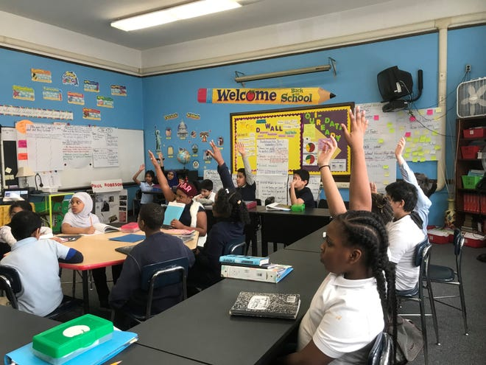
Today’s System Does Not Serve All Students
The system was never set up to serve all kids. It has very, very, reliably serviced about 30% - no matter what we do - and about 40% get through it - and about 30% don't do very well. And [that percentage rises to] 50% if you're [in] a targeted population. And that is not a new number. . . . We've been doing that consistently, and we are still doing that.
Peter McWalters, Former Commissioner of Rhode Island
Every adult in Rhode Island owes it to Providence students to change this.
Notes:
https://capitoltvri.cablecast.tv/show/3012?site=1
Peter was Commissioner from 1992-2009

Slide 18
Questions?
Thank you!

